Slide 1

InpaintGAN - Generate image inpainting with adversarial edge learning
Capstone Project Phase 2 - 23-1-R-13
Students:
Tal Yehoshua and Moshe Peretz
Supervisors:
Dr. Renata Avros and Prof. Zeev Volkovich
1

Slide 2
Table of Contents
What is image inpainting?
Dataset
Demo
Enhanced Gated Convolution
Hyperparameters
Testing plan
EfficientNet
Inpaint GAN Models
Conclutions
Spatial variant reconstruction loss
Performance evaluation matrix
2

Slide 3
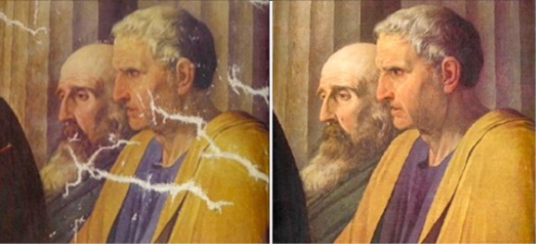
What is image inpainting?
Image inpainting is a process of filling in missing or corrupted parts of an image with realistic content.
Challenging task due to the need for the model to understand the context and semantics of the image in order to generate plausible content.
3

Slide 4
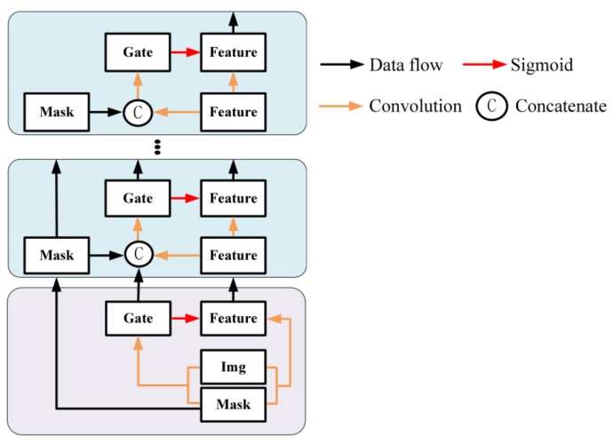
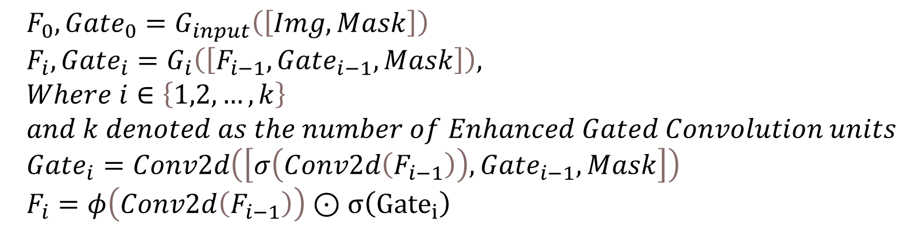
Enhanced Gated Convolution
Enhanced Gated Convolution is an approach that improves the performance of Gated Convolution and regular Convolution
EGC has an attention mechanism to better capture contextual information, selectively highlighting relevant elements for inpainting.
$$F_{0},Gate_{0}=G_{input}\left(\left[Img, Mask\right]\right) \\ F_{i},Gate_{i}=G_{i}\left(\left[F_{i−1},Gate_{i−1},Mask\right]\right), \\ Where i∈\left\{1,2,…,k\right\} \\ and k denoted as the number of Enhanced Gated Convolution units \\ Gate_{i}=Conv2d\left(\left[σ\left(Conv2d\left(F_{i−1}\right)\right),Gate_{i−1},Mask\right]\right) \\ F_{i}=φ\left(Conv2d\left(F_{i−1}\right)\right)⊙σ\left({Gate}_{i}\right)$$
4
Notes:
The standard convolution applies the same filter to all valid, invalid, and mixed pixels. It is likely to result in visual artifacts such as color inconsistency and blurriness for inpainting images with irregularities. To make the convolution operation dependent only on valid pixels, partial convolution [22] was introduced with a masking and re-normalization step. However, all channels in each network layer share the same mask which can be viewed as an un-learnable feature hard gating. To address this limitation, gated convolution [21] has been proposed for learning a dynamic feature selection mechanism. As shown in Fig. 2 (left), the gating values in each layer are obtained by re-convolutional mapping of the current layer’s feature maps. However, the input mask and the gating information for the current layer are not used for the next layer, and thus the gating information would gradually diminish with the increase of convolutional layers.

Slide 5
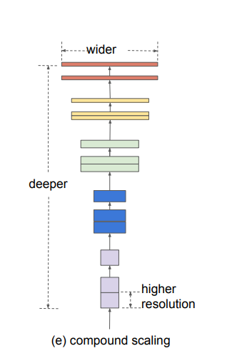
EfficientNet
EfficientNet is a collection of convolutional neural networks (CNNs) designed to attain high accuracy while remaining computationally efficient.
EfficientNet's architecture includes compound scaling, which balances the network's depth, width, and resolution, resulting in enhanced performance.
EfficientNet has repeatedly outperformed previous state-of-the-art models across a wide range of image recognition tasks, outperforming them while demanding fewer computer resources.
5

Slide 6
Spatial variant reconstruction loss
Spatial variant reconstruction loss is a novel technique used in image inpainting tasks to improve the quality of the inpainted images.
Unlike classic reconstruction loss, which analyzes the entire image identically, spatial variant reconstruction loss weights different sections of the image based on their usefulness for inpainting.
Spatial variation reconstruction loss motivates the model to prioritize the proper reconstruction of these crucial regions by allocating greater weights to places with more missing information, resulting in more visually appealing and realistic inpainted images.
6
Notes:
The spatial variant reconstruction loss, as described in your question, is primarily designed for image inpainting tasks where pixel-level reconstruction is crucial. The loss function assigns a larger weight to the completed pixels closer to the boundary, encouraging the damaged area near the filling boundary to resemble its intact neighbor pixels.
Spatial variant reconstruction loss For the image inpainting task [12,13,15], pixel level reconstruction loss is important. Considering that missing pixels close to hole boundaries have more correlations with known pixels than those closing to the central part. Therefore, the spatial variant reconstruction loss [44] is employed for calculating the reconstruction loss. The loss value of the completed pixel closer to the boundary accounts for a larger weight, thereby forcing the damaged area close to the filling boundary to approach its real intact neighbor pixels.

Slide 7
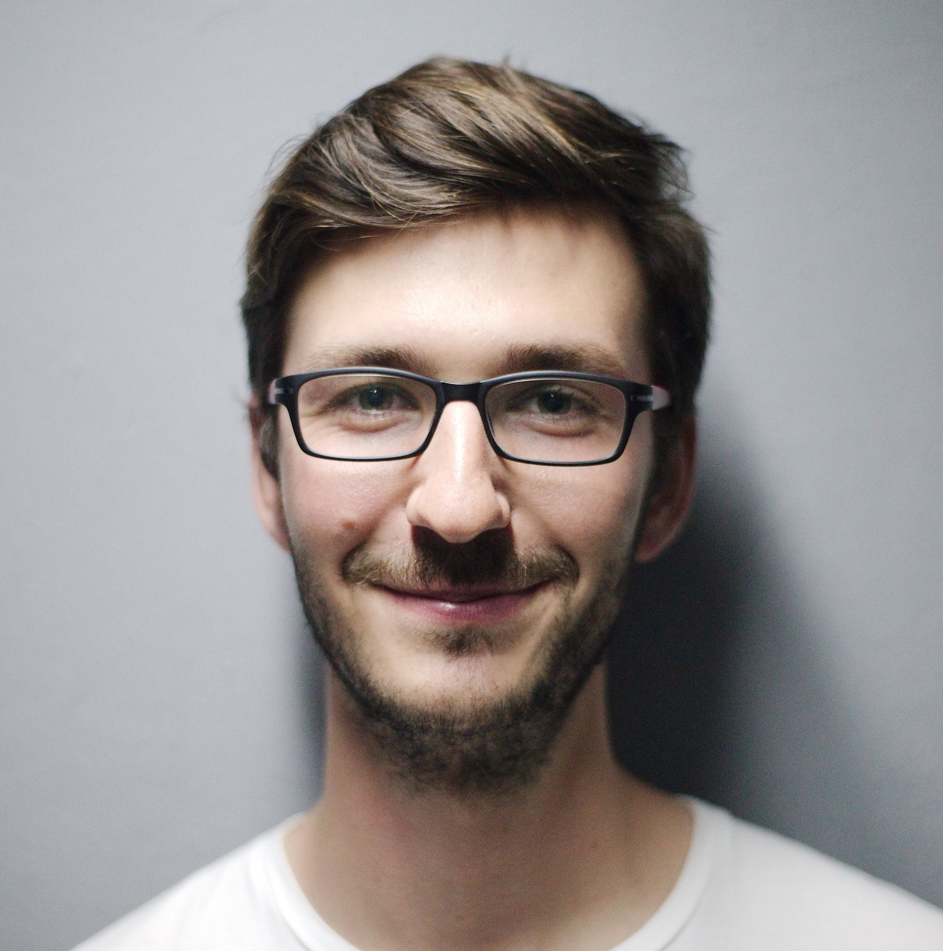
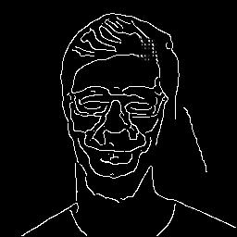
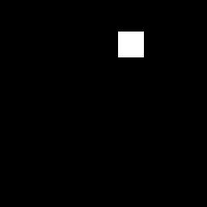
Dataset
Experiments on the models were evaluated on the HumanFaces dataset containing 7,219 images.
Randomly selected 80% images for training and 20% for testing.
The images are resized with the resolution of 256x256.
Each image is being match with a randomly placed 32x32 block mask.
Canny Edge Detector is employed to extract the outlines of the image.
7

Slide 8
InpaintGAN Training Hyperparameters
Learning rate – 0.001
Discriminator Generator learning rate ratio – 0.1
Adam optimizer $β_{1}|β_{2}$ - 0.0|0.9 (For learning rate decay)
Batch size – 8
Input size – 256
Sigma(For Canny Edge Detector) – 2
Max Iterations – 2 $⋅$ ${10}^{6}$
$L_{1}$ loss weight – 1
FM loss weight – 10
Style loss weight – 1
Content loss weight
Inpaint adversarial loss weight – 0.01
GAN loss – Binary Cross Entropy
Edge threshold – 0.5
8

Slide 9
InpaintGAN – EffU-net
InpaintGAN - EGC
Inpaint GAN Models
InpaintGAN – EGC + SVR loss
InpaintGAN - AvgPooling
9

Slide 10
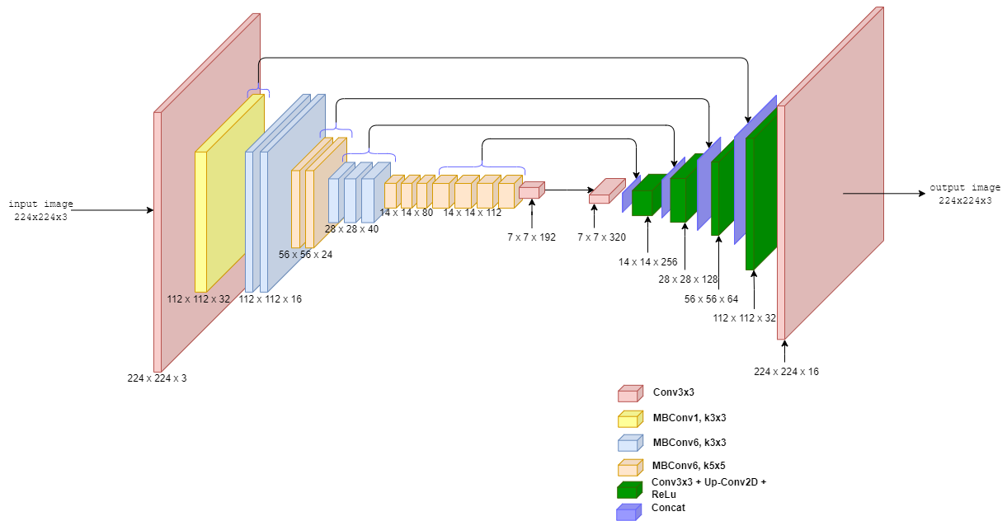
InpaintGAN – EffU-net
The Edge Generator solution first leveraged the widely used EfficientNet model and U-Net architecture.
Many obstacles developed throughout the testing process, demonstrating the model's limitations in efficiently inpainting. EfficientNet, which was built primarily for image classification, was insufficient for the desired purpose.
10

Slide 11
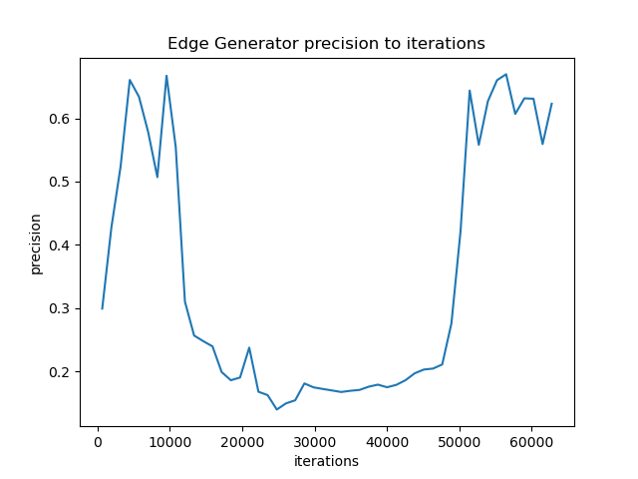
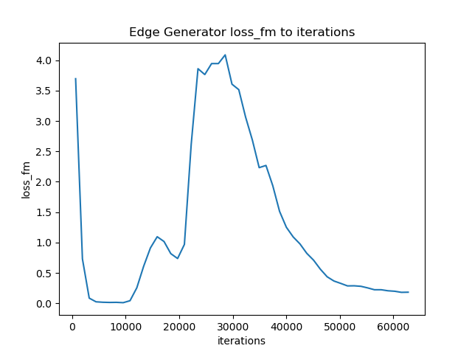
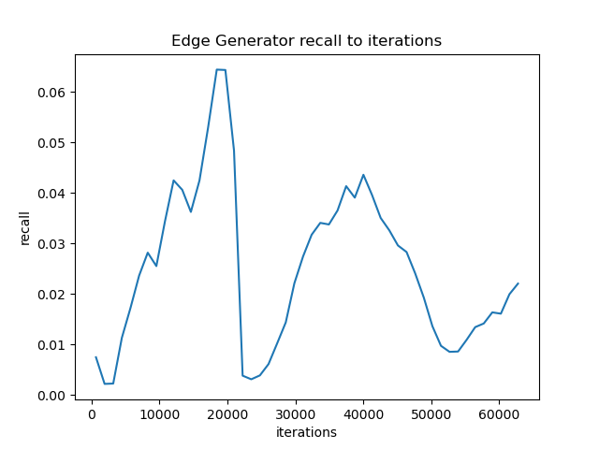
InpaintGAN – EffU-net - Results
The Edge Generator solution first leveraged the widely used EfficientNet model and U-Net architecture.
Many obstacles developed throughout the testing process, demonstrating the model's limitations in efficiently inpainting. EfficientNet, which was built primarily for image classification, was insufficient for the desired purpose.
11

Slide 12
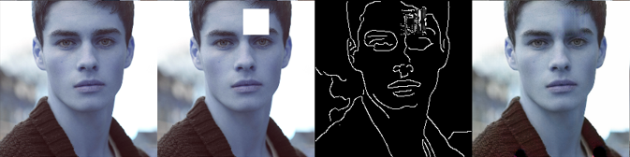
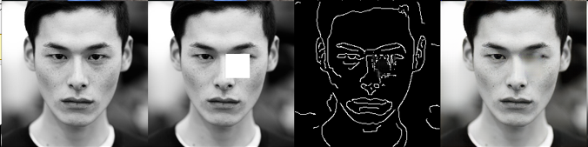
InpaintGAN – EffU-net - Results
12

Slide 13
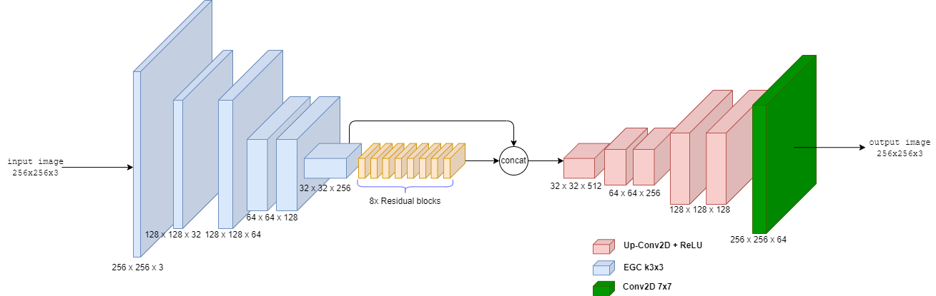
InpaintGAN EGC Model
Enhanced Gated Convolution was used for the encoder, residual block for the middle section, and regular convolutions for the decoder.
In this model, after 10% of training time the loss value began to increase.
13
Notes:
For our second model, we used EGC layers as the encoder, followed by 8 residual blocks, and regular convolutions.
After 10% of the recommended training time as mention in EdgeConnect, the model loss value starts to increase.

Slide 14
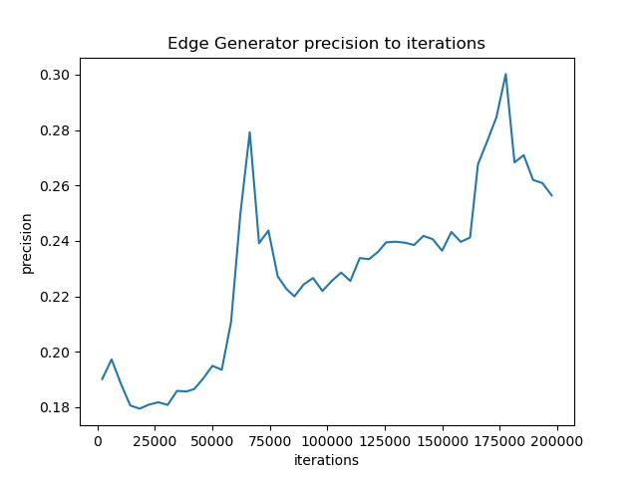
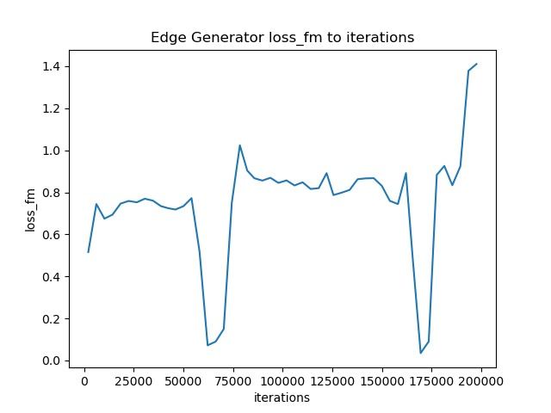
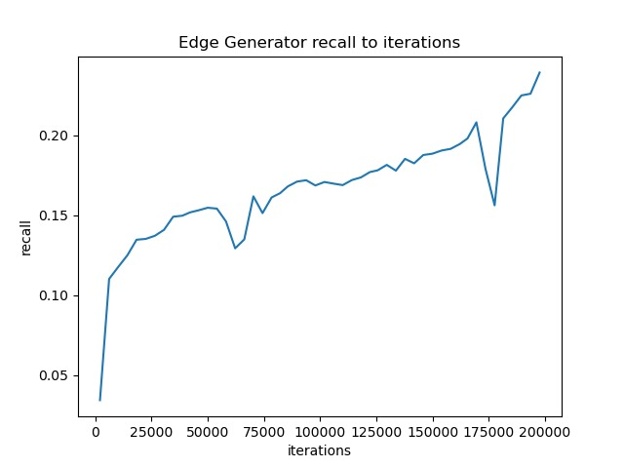
InpaintGAN EGC Model - Results
The model was performing poorly, the reasons for this may be:
1. Inadequate training duration
2. Inappropriate loss function.
3. Gradient vanishing/exploding
4. Hyperparameter tuning
14
Notes:
As we can see, our model didn't perfome well.
The reason for this may be due to not enough training time, the loss function isnt good
gradiant vanishing or we didnt find the right tuning for the hyperparameter.

Slide 15
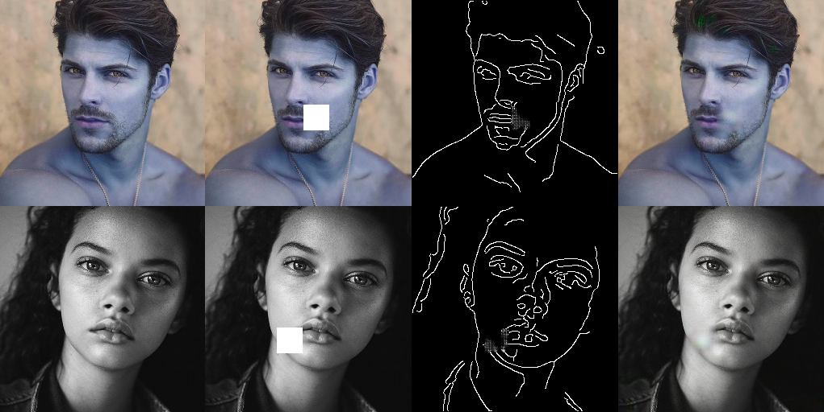
InpaintGAN EGC Model - Results
15
Notes:
In this sample of the EGC model, we can see that our model did predict the area where the
edges should inpainted but with very low accuracy. It didnt inpaint fine details correctly.

Slide 16
InpaintGAN EGC + SVR loss Model
This model is same as the EGC model except we used Spatial Variant Reconstruction loss to see if the loss function play important role in the performance of the model.
16
Notes:
For out third model, we use the same model as the previous one but add SVR loss. We wanted to check
if the loss function play important role in the performance of the model.

Slide 17
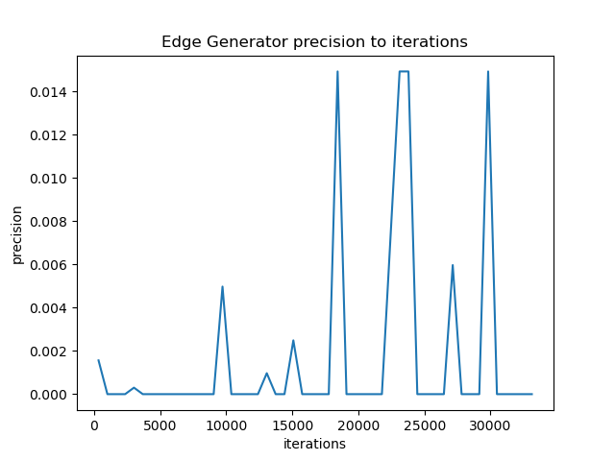
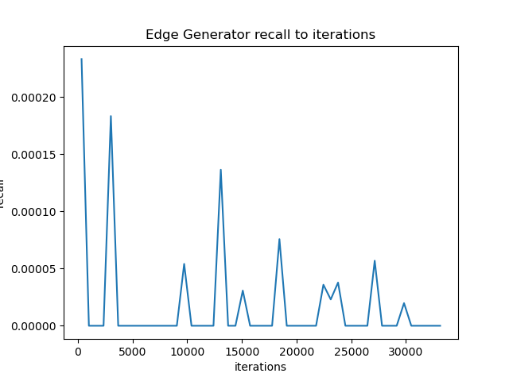
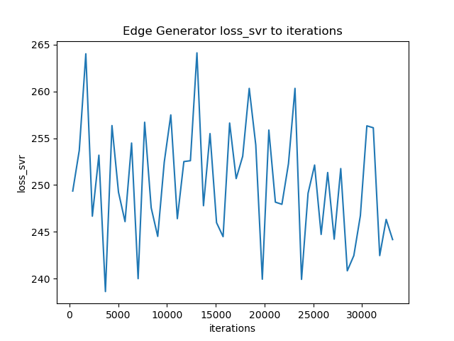
InpaintGAN EGC + SVR loss Model - Results
The model failed due to an unsuitable loss function. It measures pixel reconstruction consistency, which does not align with the nature of edge map generation. Edge maps lack pixel correlations, unlike RGB images where neighboring pixels are related. This mismatch hindered the model's ability to generate accurate edge maps.
17
Notes:
We can see from our graphs that the model didnt learn at all.
this could be due to the SVR used to capture correlation between pixels with 3 dimentions value
and our edge map is with only 1 dimention with the value of 0 or 1.

Slide 18
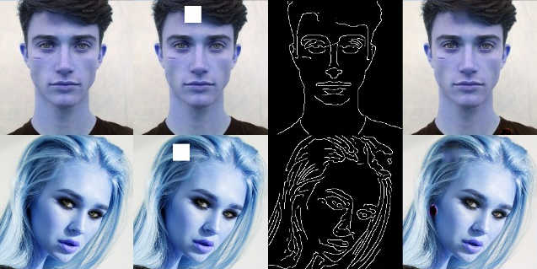
InpaintGAN EGC + SVR loss Model - Results
18

Slide 19
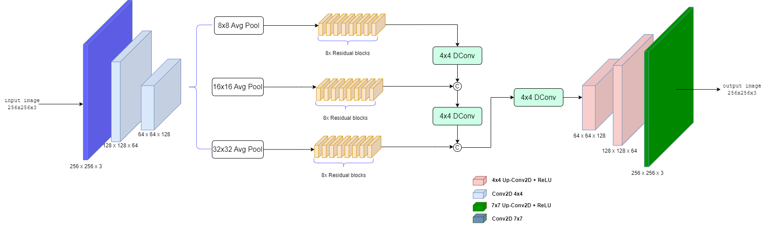
InpaintGAN - Multi-scale Edge
Completion
The goal of edge completeness is to rebuild missing or partial edge information using the image's existing context. This is accomplished by examining the surrounding edge structure and making assumptions to fill in the gaps.
The multi-scale element of edge completion entails taking into account edges at various levels of complexity or resolution. Images include edges at different scales, from small details to bigger global structures.
19
Notes:
For our final and best model, we use Multi-scale Edge Completion. In this model we used the feature map
from our encoder and extract features from different scales to capture local structure and global structure.
We than concatenate the features it go through the decoder.

Slide 20
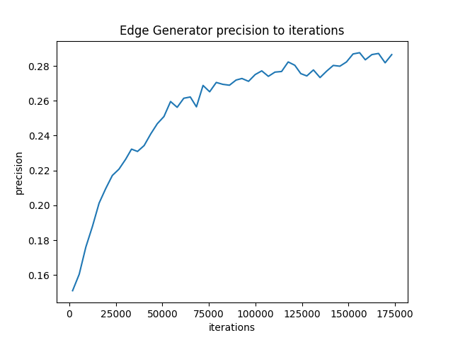
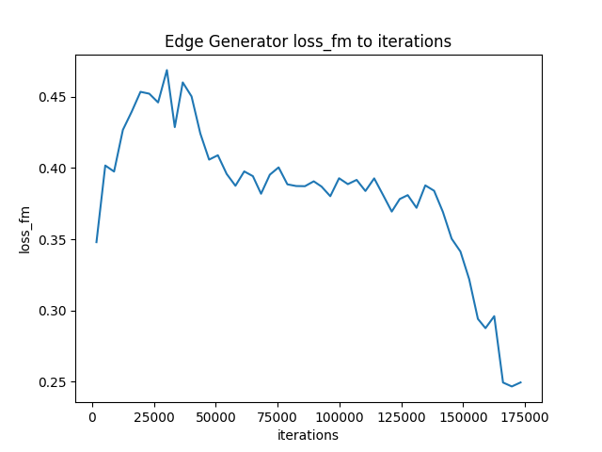
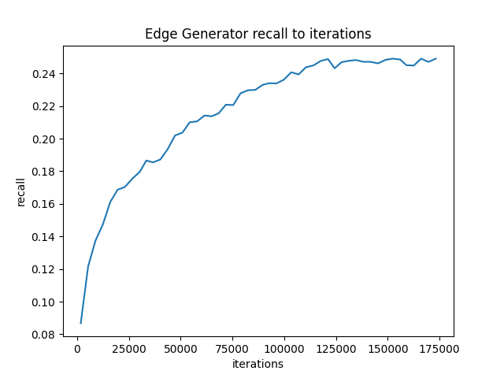
InpaintGAN – Multi-scale Edge
Completion - Results
The findings indicate that this model outperformed the recent models. However, it was not possible to train the model beyond 10% of the specified number of iterations mentioned in EdgeConnect.
20
Notes:
Our results show that our final model outperformed the recent models. Note that we didn't train the model
beyond 10% of the specified number of iteration mention in EdgeConnect.

Slide 21
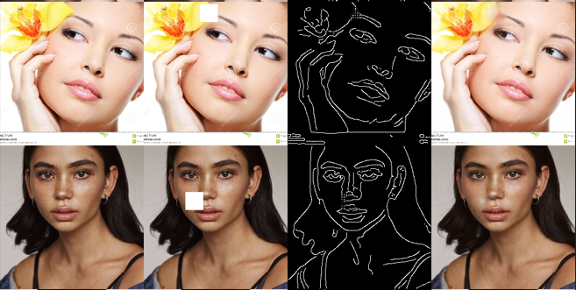
InpaintGAN – Multi-scale Edge
Completion - Results
21

Slide 22
Performance evaluation metrics
$$Precision=\frac{TP}{TP+FP}$$
Precision focuses on the accuracy of the positive predictions made by the model.
Precision indicates the proportion of true positive predictions out of all positive predictions made by the model.
A high precision indicates a low rate of false positives.
ACTUAL VALUES
Negative (N) | Positive (P)
False Positive (FP) | True Positive (TP) | Positive (P) | PREDICTED VALUES
True Negative (TN) | False Negative (FN) | Negative (N)
22
Notes:
Precision indicate the proportion of true positive prediction out of all positive predictions
made by the model.

Slide 23
Performance evaluation metrics
$$Recall=\frac{TP}{TP+FN}$$
A measure of actual observations which are predicted correctly.
Recall represents the proportion of true positive predictions out of all actual positive instances.
The Recall should be as high as possible.
ACTUAL VALUES
Negative (N) | Positive (P)
False Positive (FP) | True Positive (TP) | Positive (P) | PREDICTED VALUES
True Negative (TN) | False Negative (FN) | Negative (N)
23
Notes:
Recall represents the proportion of true positive prediction out of all actual positive instances.
It indicate how accurate the model is.

Slide 24
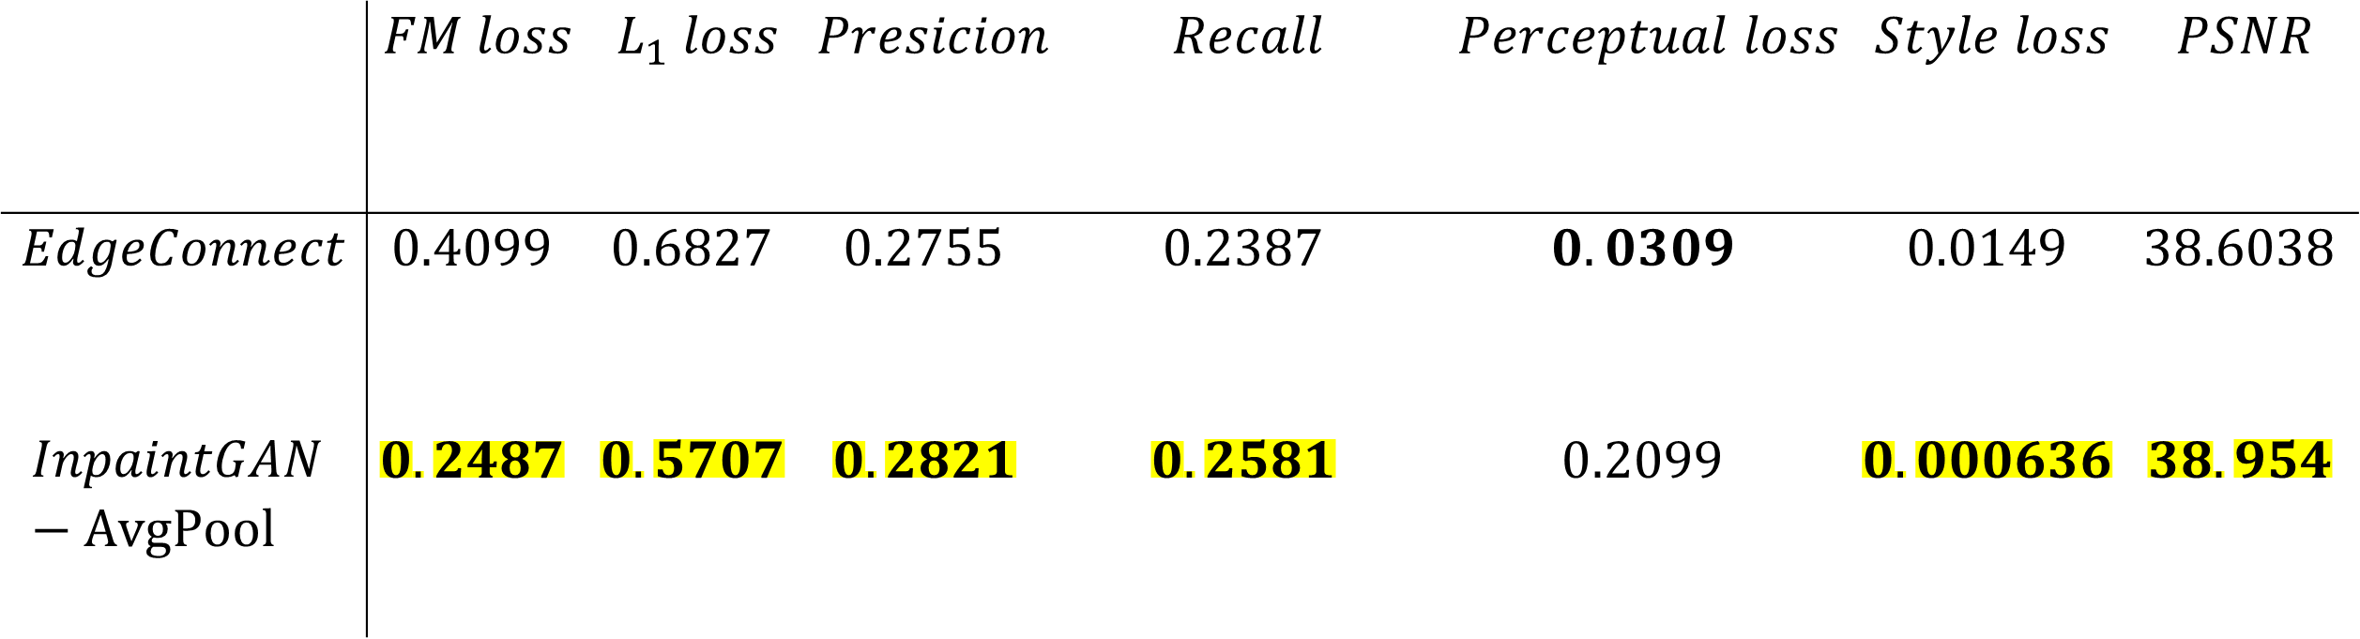
Models comparison
 | $$FM loss$$ | $$L_{1} loss$$ | $$Presicion$$ | $$Recall$$ | $$Perceptual loss$$ | $$Style loss$$ | $$PSNR$$
$$EdgeConnect$$ | $$0.4099$$ | $$0.6827$$ | $$0.2755$$ | $$0.2387$$ | $$0.0309$$ | $$0.0149$$ | $$38.6038$$
$$InpaintGAN −AvgPool$$ | $$0.2487$$ | $$0.5707$$ | $$0.2821$$ | $$0.2581$$ | $$0.2099$$ | $$0.000636$$ | $$38.954$$
24

Slide 25
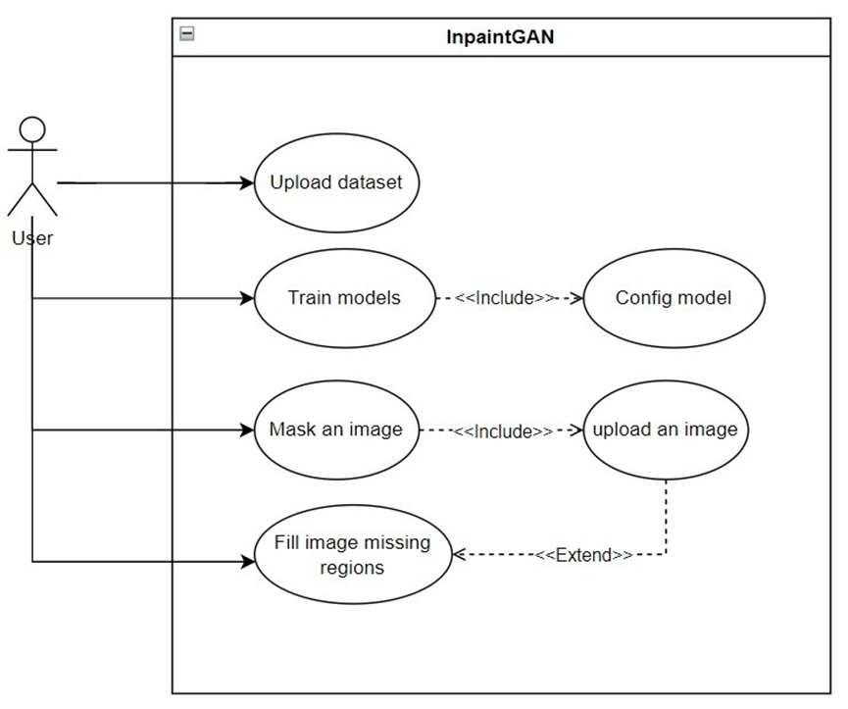
UML diagrams – Use case
25

Slide 26
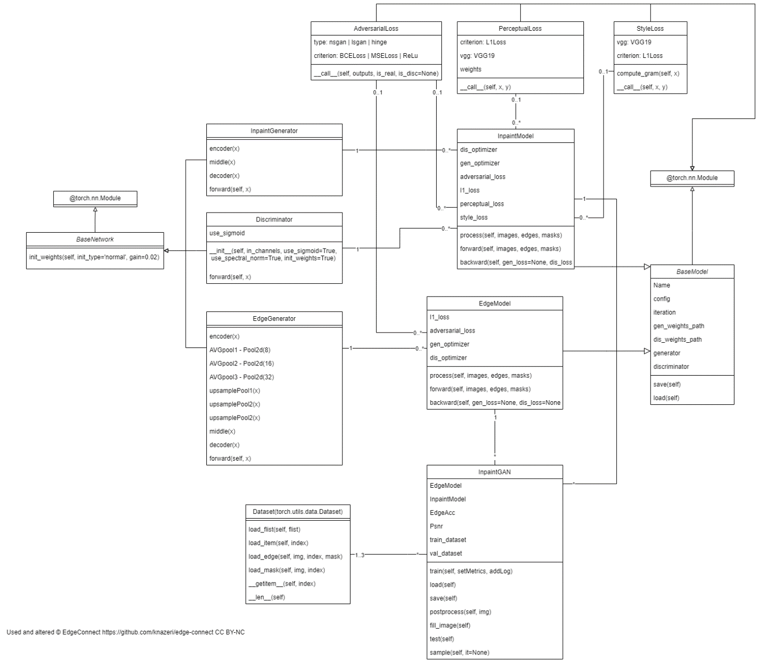
UML diagrams - Class
24
26

Slide 27
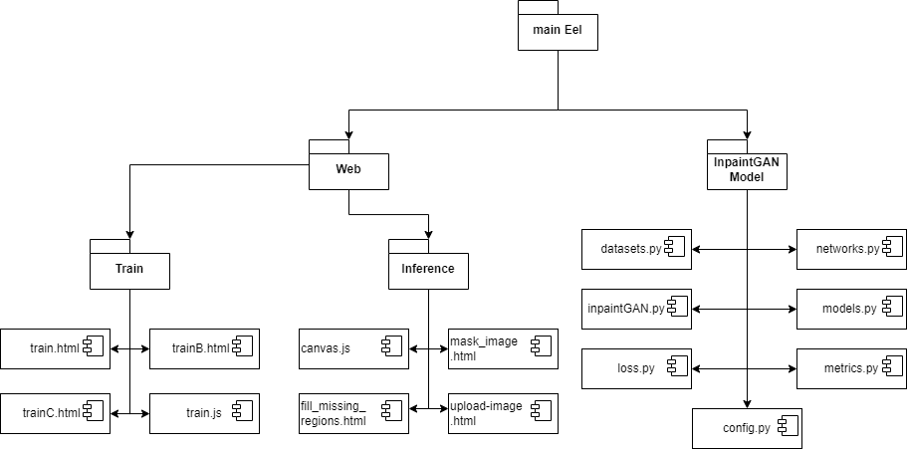
UML diagrams - Package
27

Slide 28
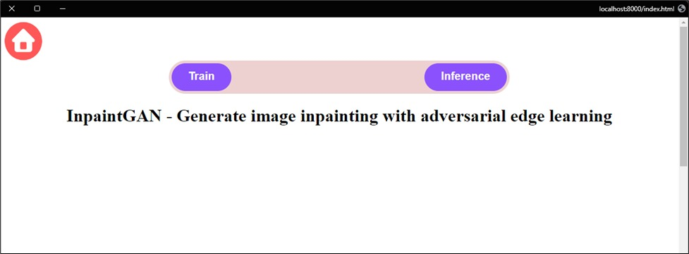
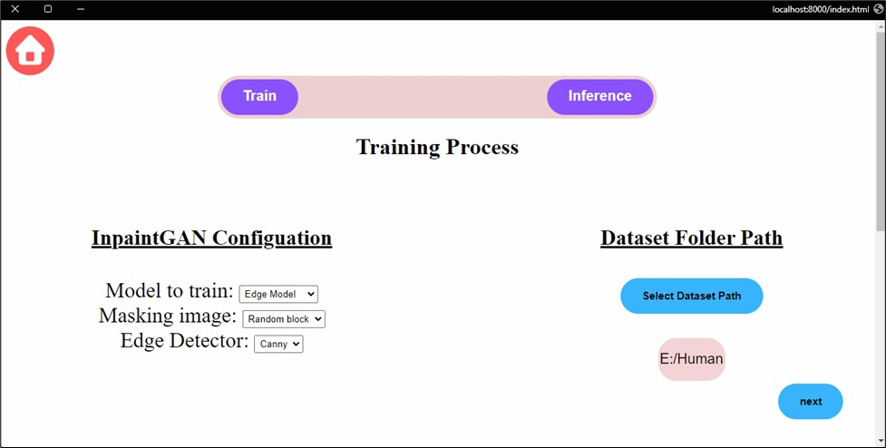
GUI
28

Slide 29
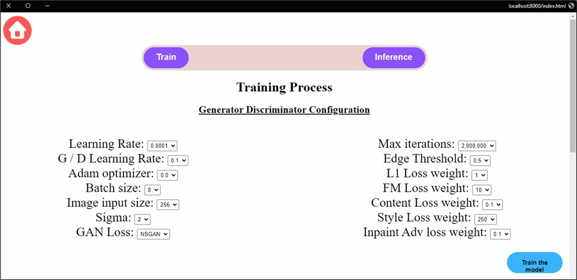
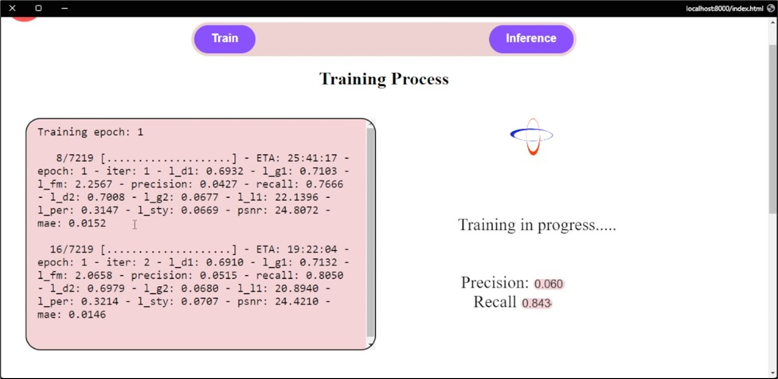
GUI
29

Slide 30
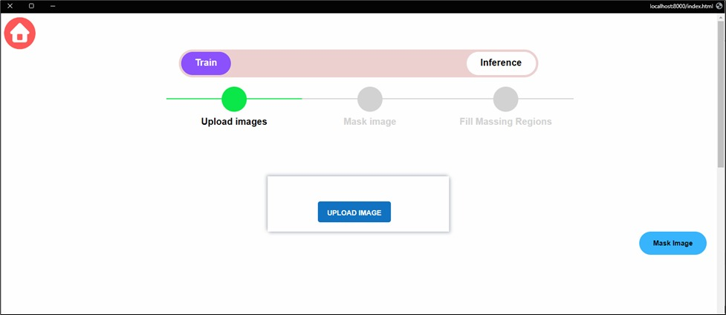
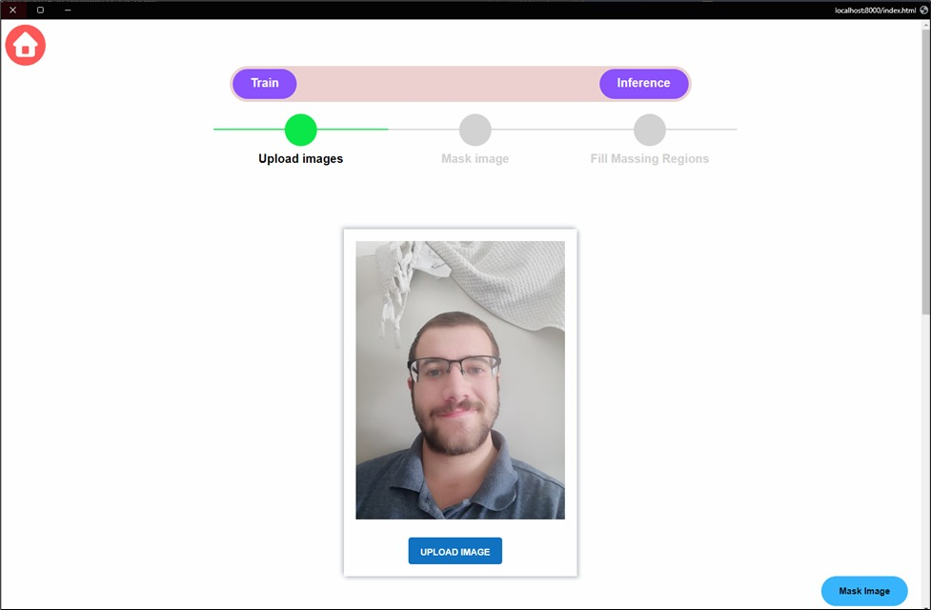
GUI
30

Slide 31
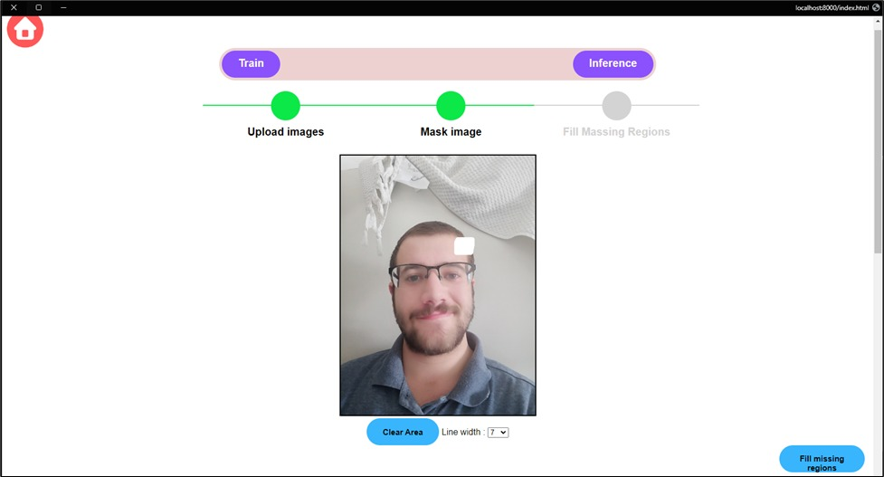
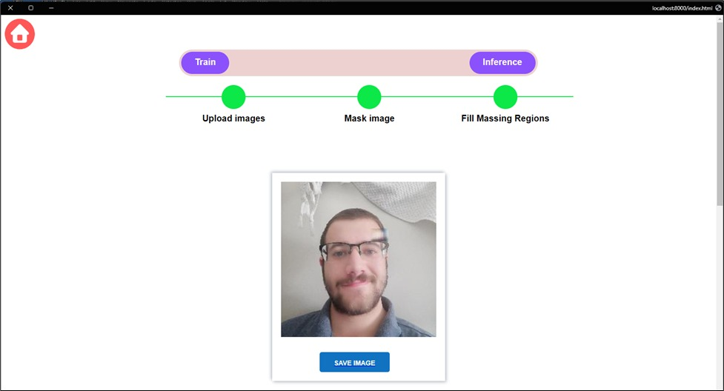
GUI
31

Slide 32

GUI Demo
32

Slide 33
GUI Testing Plan
Test | Module | Test Description | Expected Result
1 | Main window | Click ‘Home’ button. | Open ‘Home’ window.
2 | Main window | Click ‘Train’ button. | Open ‘Train’ window.
3 | Main window | Click ‘Inference’ button. | Open ‘Inference’ window.
4 | Train window -> InpaintGAN configuration | Click Drop-down ‘Model to train List’ and choose ‘Edge Model’. | Option ‘Edge Model’ should be chosen.
5 | Train window -> InpaintGAN configuration | Click Drop-down ‘Model to train List’ and choose ‘Inpaint Model. | Option ‘Inpaint Model’ should be chosen.
6 | Train window -> InpaintGAN configuration | Click Drop-down ‘Model to train List’ and choose ‘Joint Model’. | Option ‘Joint Model’ should be chosen.
33

Slide 34
GUI Testing Plan - ctnd
Test | Module | Test Description | Expected Result
7 | Train window -> InpaintGAN configuration | Click Drop-down ‘Masking image’ and choose ‘Random block’. | Option ‘Random block’ should be chosen.
8 | Train window -> InpaintGAN configuration | Click Drop-down ‘Edge Detector’ and choose ‘Canny’. | Option ‘Canny’ should be chosen.
9 | Train window -> Dataset folder path | Click ‘Select Dataset Path’ and select the dataset folder. | The path should be written below the button
10 | Train window -> Dataset folder path | Click ‘next’ without selecting a folder. | Error message saying ‘Dataset path is not defined’ should be written in Red below the path.
11 | Train window -> Training Process | Click on button ’next’. | Open training configuration window.
28

Slide 35
GUI Testing Plan - ctnd
Test | Module | Test Description | Expected Result
12 | Train window -> Generator Discriminator configuration | Click Drop-down ‘Learning Rate’ and choose ‘0.0001’. | Option ‘0.0001’ should be chosen.
13 | Train window -> Generator Discriminator configuration | Click on button ’Train The Model’. | Open active training with timer window.
14 | Inference window -> upload images | Click on ‘Upload Image’. | Open the file explorer to select the image.
15 | Inference window -> upload images | Selected an image. Click on ‘Upload Image’ and select an image. | New file selected should override the previously selected image
16 | Inference window -> upload images | Click on button ‘Mask Image’. | Open Inference window -> mask image.
29

Slide 36
GUI Testing Plan - ctnd
Test | Module | Test Description | Expected Result
17 | Inference window -> mask images | Mask an image using the eraser. | The image erased parts should be white only without any image underneath.
18 | Inference window -> mask images | Mask an image using the cursor. | The image should be saved after erasing the parts.
19 | Inference window -> mask images | Select a different ‘Line width’ 7 | The cursor drawing line should be to the selected width 7
20 | Inference window -> mask images | Click ‘Clear Area’ | Should clear all drawn white lines.
21 | Inference window -> mask images | Click on button ‘Fill missing regions’. | Should open ‘Filling image missing regions window.
22 | Inference window -> Fill missing regions | Click on button ‘Save image’. | Should open file explorer to save the image.
30

Slide 37
Conclusion
Given the restrictions of training time, the final model has the ability to outperform EdgeConnect, as seen in the state-of-the-art comparison.
The availability of computational resources, and completing all of the suggested iterations could lead to obtaining a superior model compared to EdgeConnect.
34

Slide 38
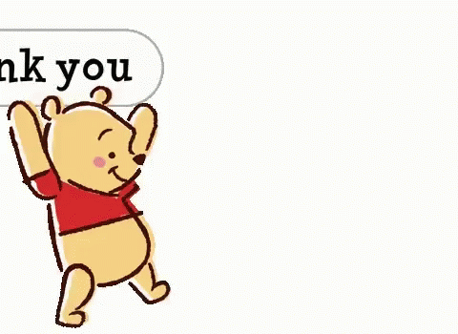
Thank You
For Listening
35

Slide 39
References
Kamyar Nazeri, Eric Ng, Tony Joseph, Faisal Z. Qureshi, Mehran Ebrahimi. EdgeConnect: Generative Image Inpainting with Adversarial Edge Learning
Mingxing Tan, Quoc V.Le. EfﬁcientNet: Rethinking Model Scaling for Convolutional Neural Networks
Cai Ran, Xinfu Li, Fang Yang: Multi-Step Structure Image Inpainting Model with Attention Mechanism
Dongsheng Wang, Chaohao Xie, Shaohui Liu, Zhenxing Niu, Wangmeng Zuo: Image Inpainting with Edge-guided Learnable Bidirectional Attention Maps
https://github.com/MoshPe/InpaintGAN
https://github.com/python-eel/Eel
Min Wang, Wanglong Lu, Jiankai Lyu, Kaijie Shi, Hanli Zhao: Generative image inpainting with enhanced gated convolution and Transformers
36

